Slide 1

What do my 150 favorite viz have in common?
And can it benefit your next projects?
Yan Holtz | Toulouse | 2022

Slide 2
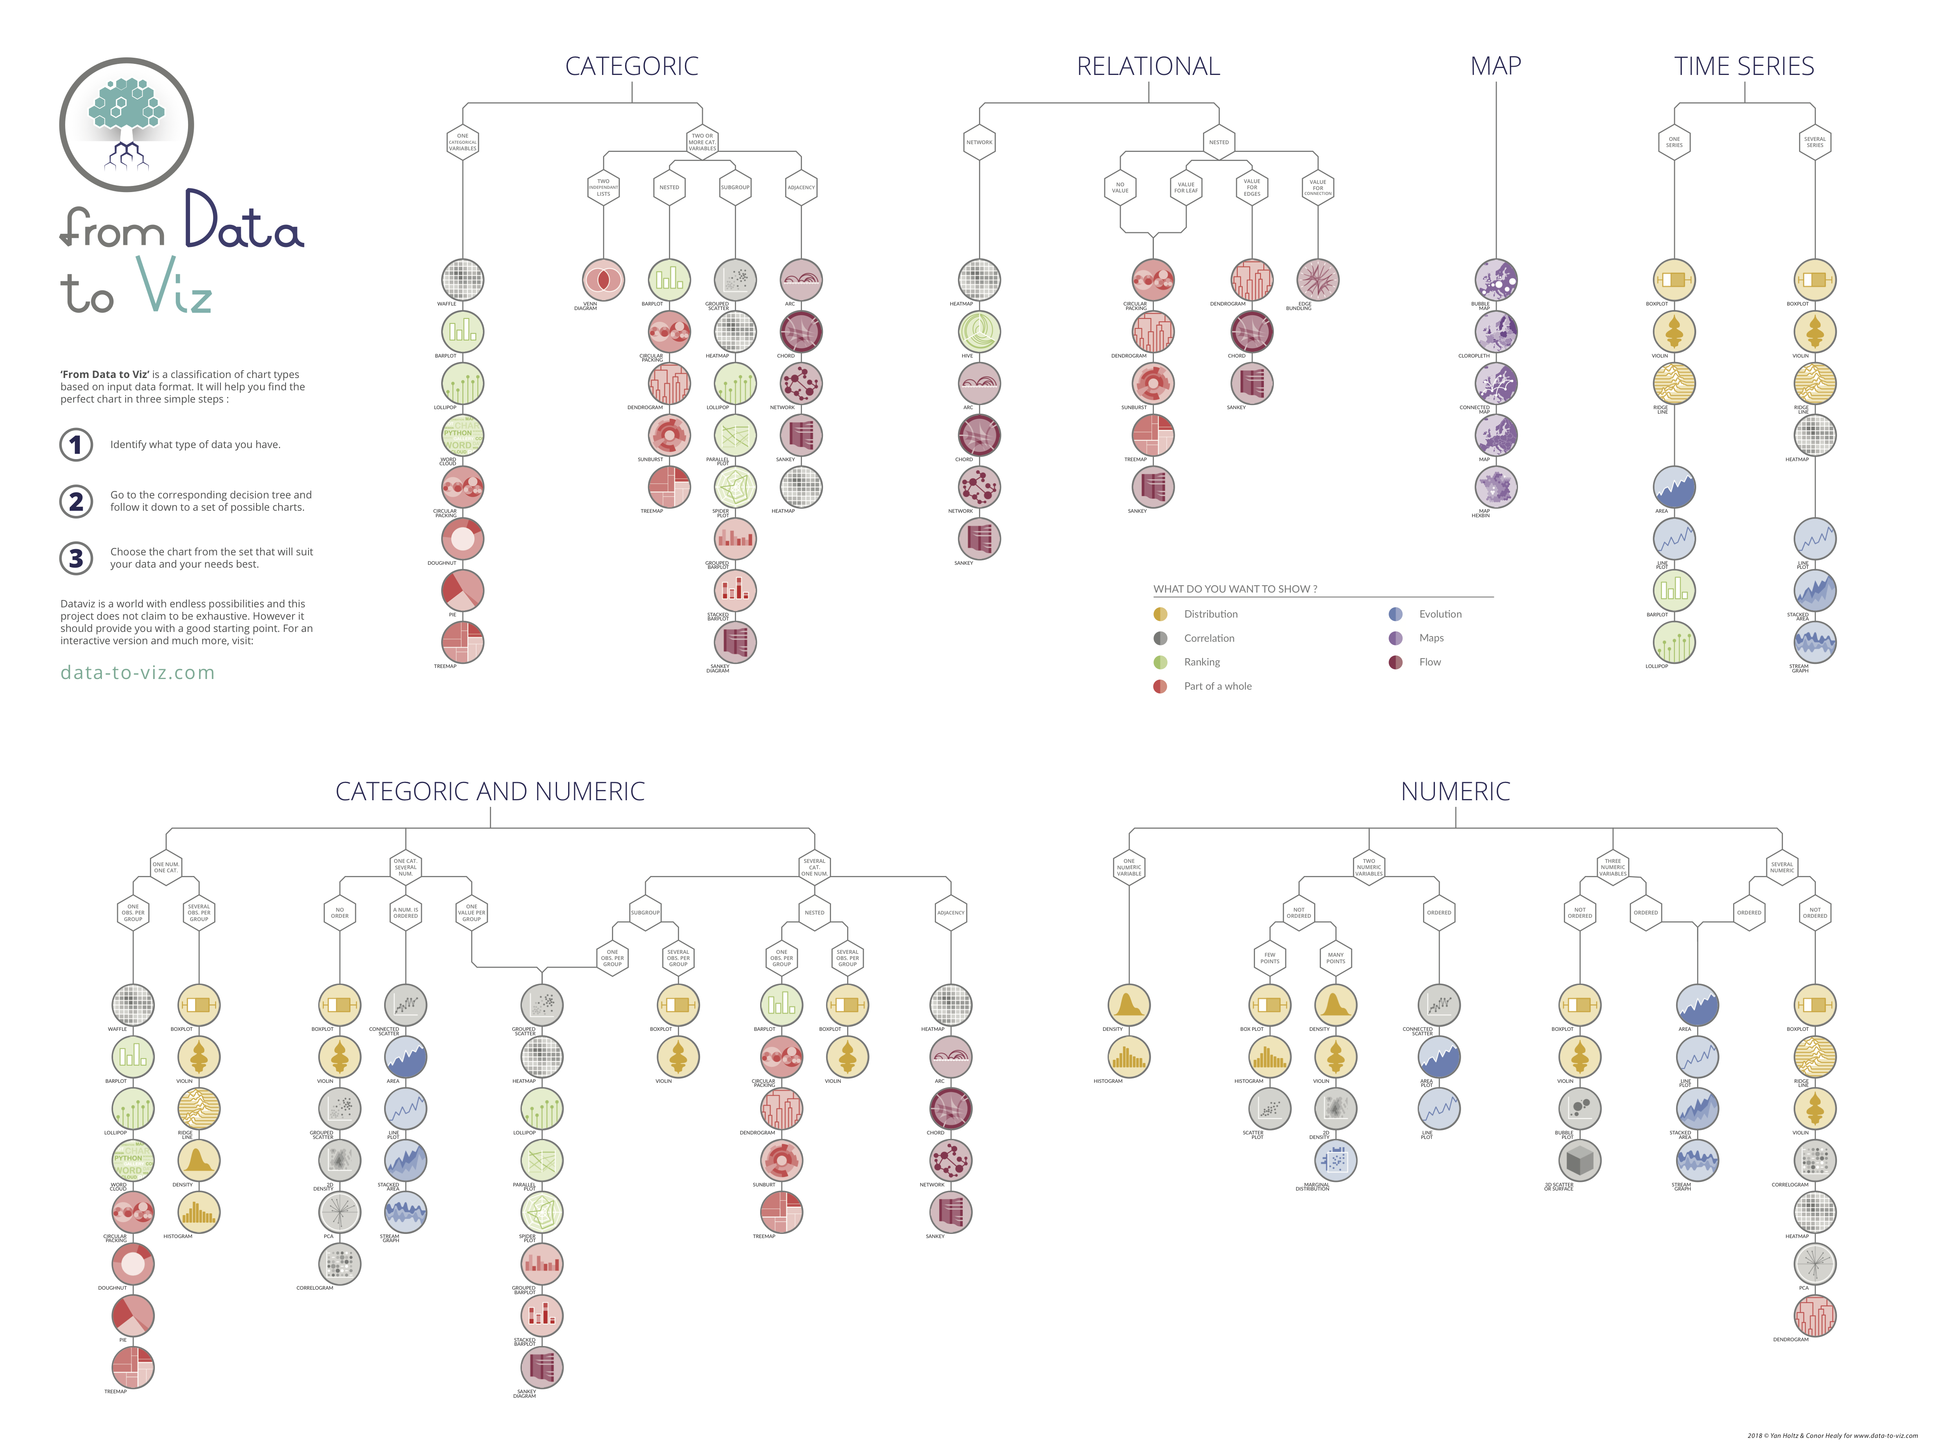
I charts
❤️

Slide 3
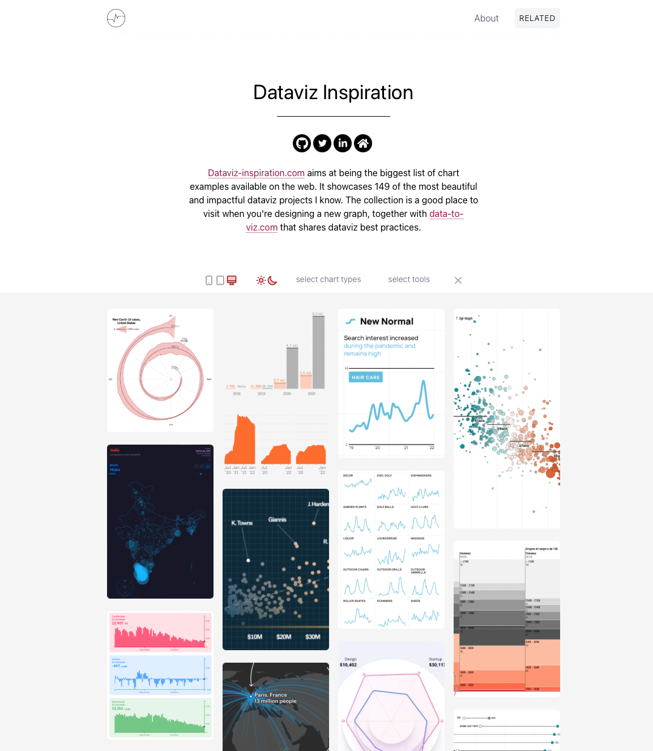
dataviz-inspiration.com

Slide 4
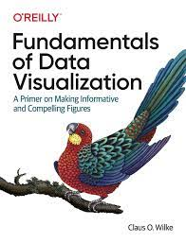
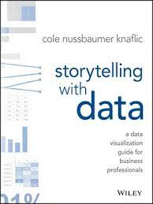
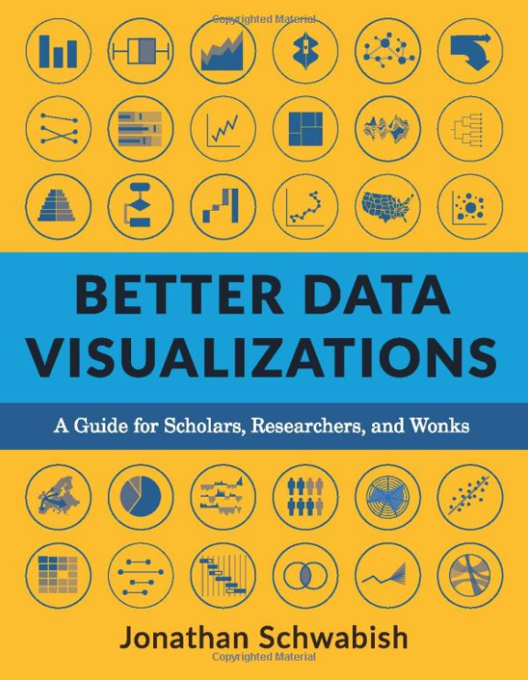
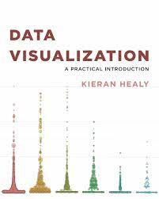

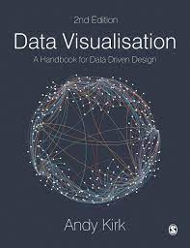
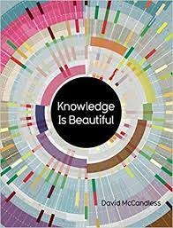
What makes a great viz… great?

Slide 5
Where do you find great charts?

Slide 6





Slide 7
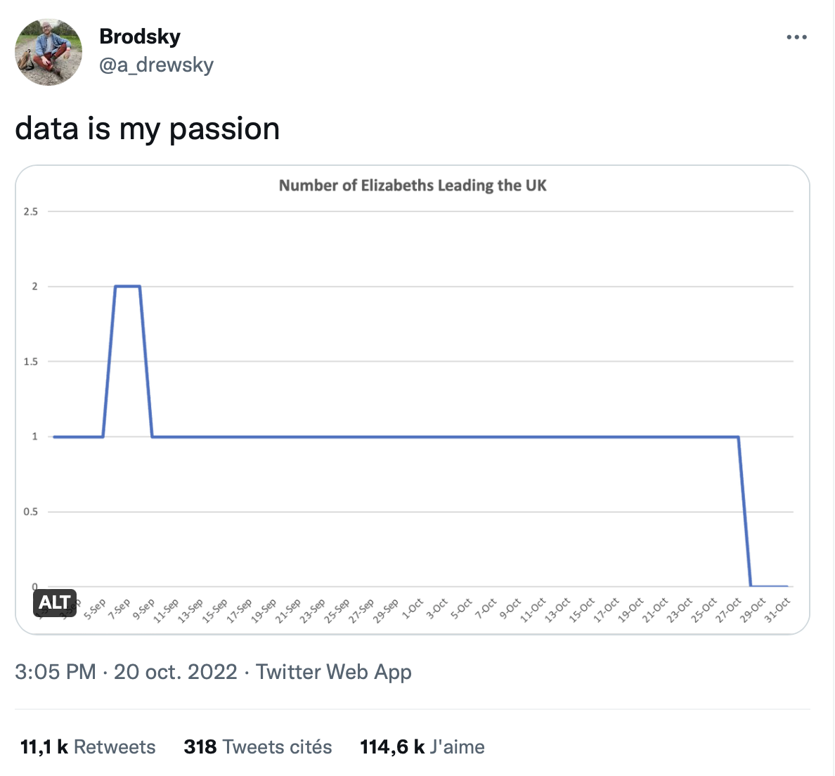
Rating a chart is hard

Slide 8
💡
Topic > Chart quality

Slide 9
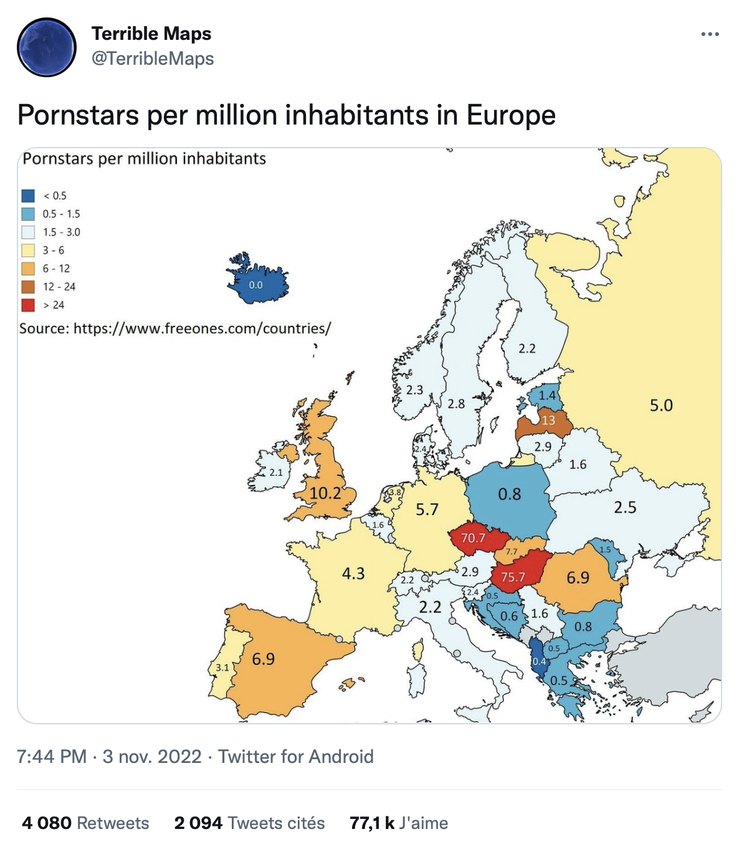

Slide 10
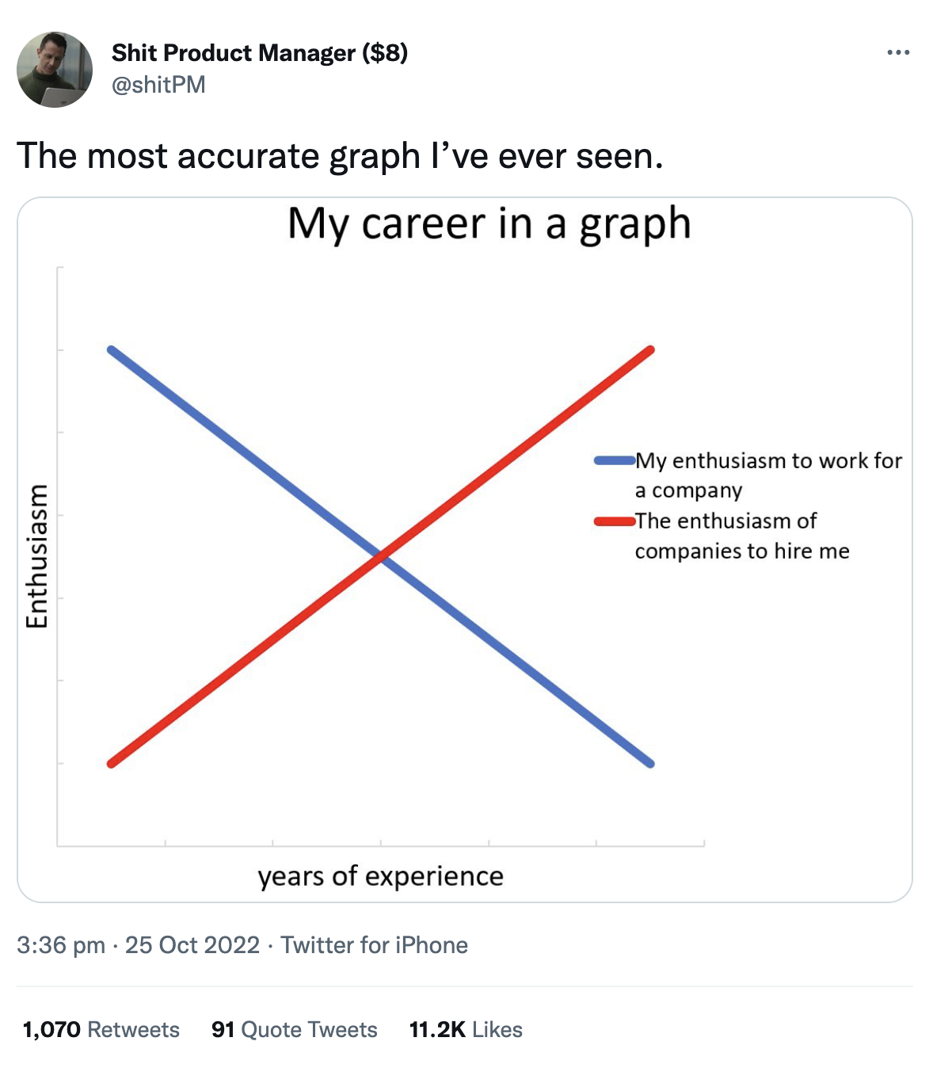

Slide 11
💡
Good viz !== Bad viz
Don’t cheat!

Slide 12
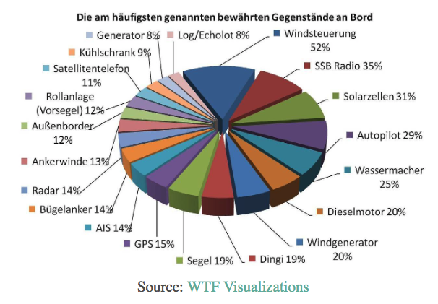
What’s wrong here?

Slide 13
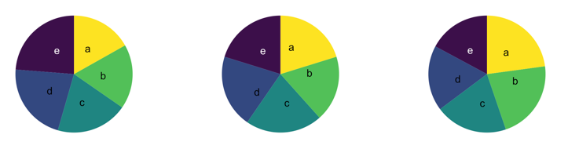
Can you see a pattern?

Slide 14
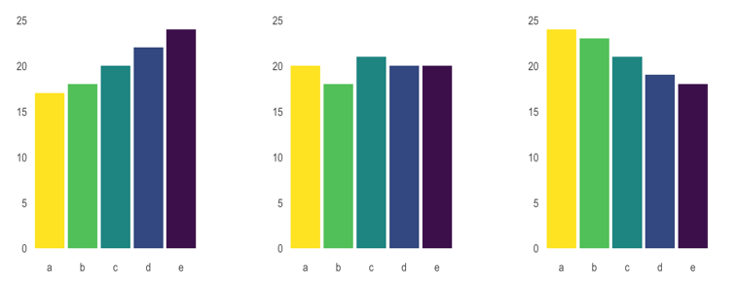

Slide 15
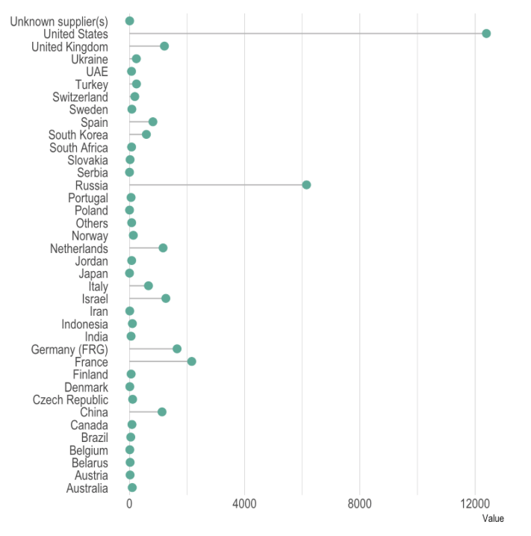
Improvement?

Slide 16
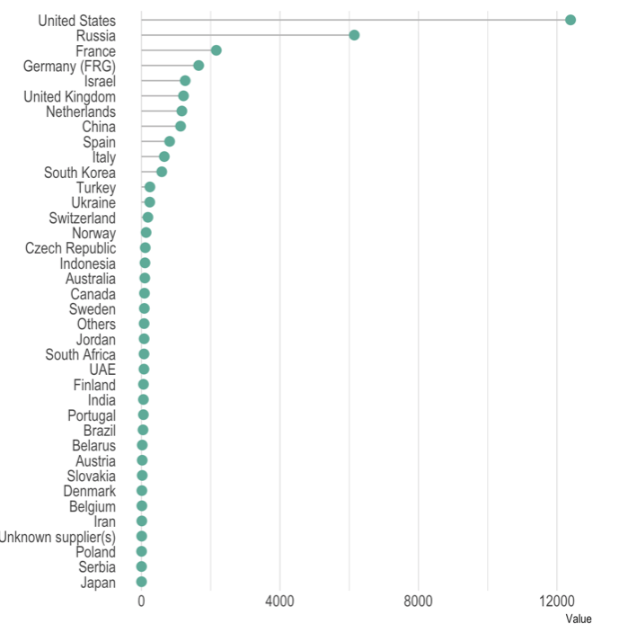

Slide 17
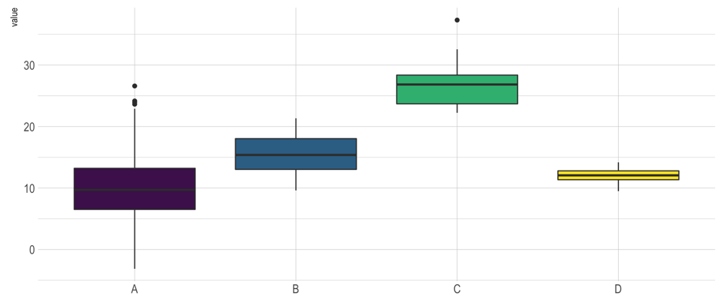
What could go wrong?

Slide 18
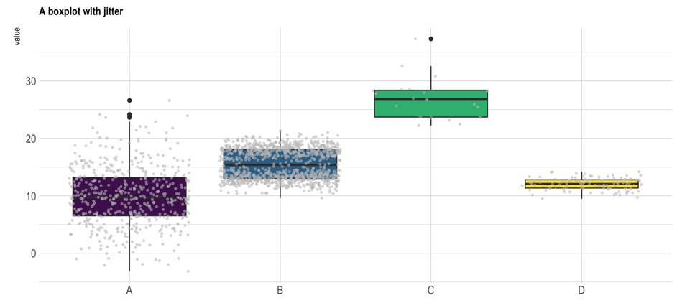
Almost no data !
Bimodal distribution

Slide 19
Boxplot = hide information
If small sample size, add data points with jitter
Almost no data !
Bimodal distribution

Slide 20
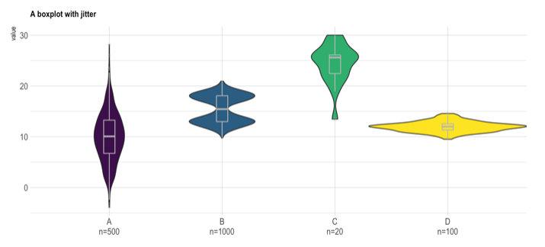
If big sample size, use violin plot
Show distribution
Show sample size

Slide 21
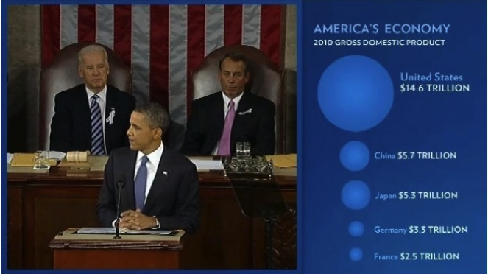
Fast Fedora blog

Slide 22
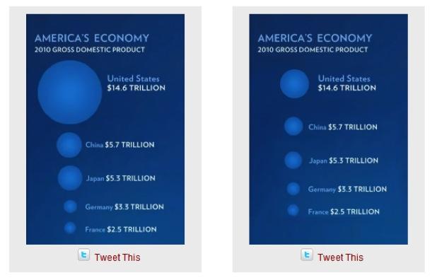
Size = radius
Size = area
Fast Fedora blog

Slide 23
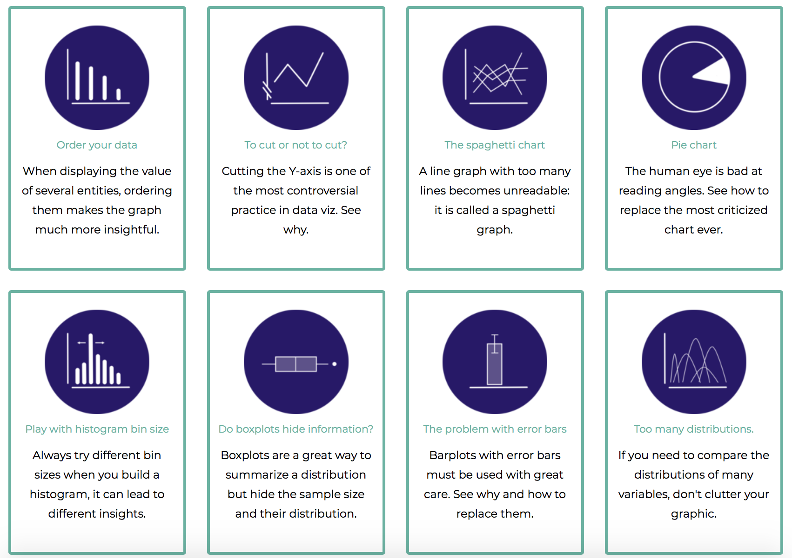
Data to viz
.com
A collection of dataviz caveats

Slide 24
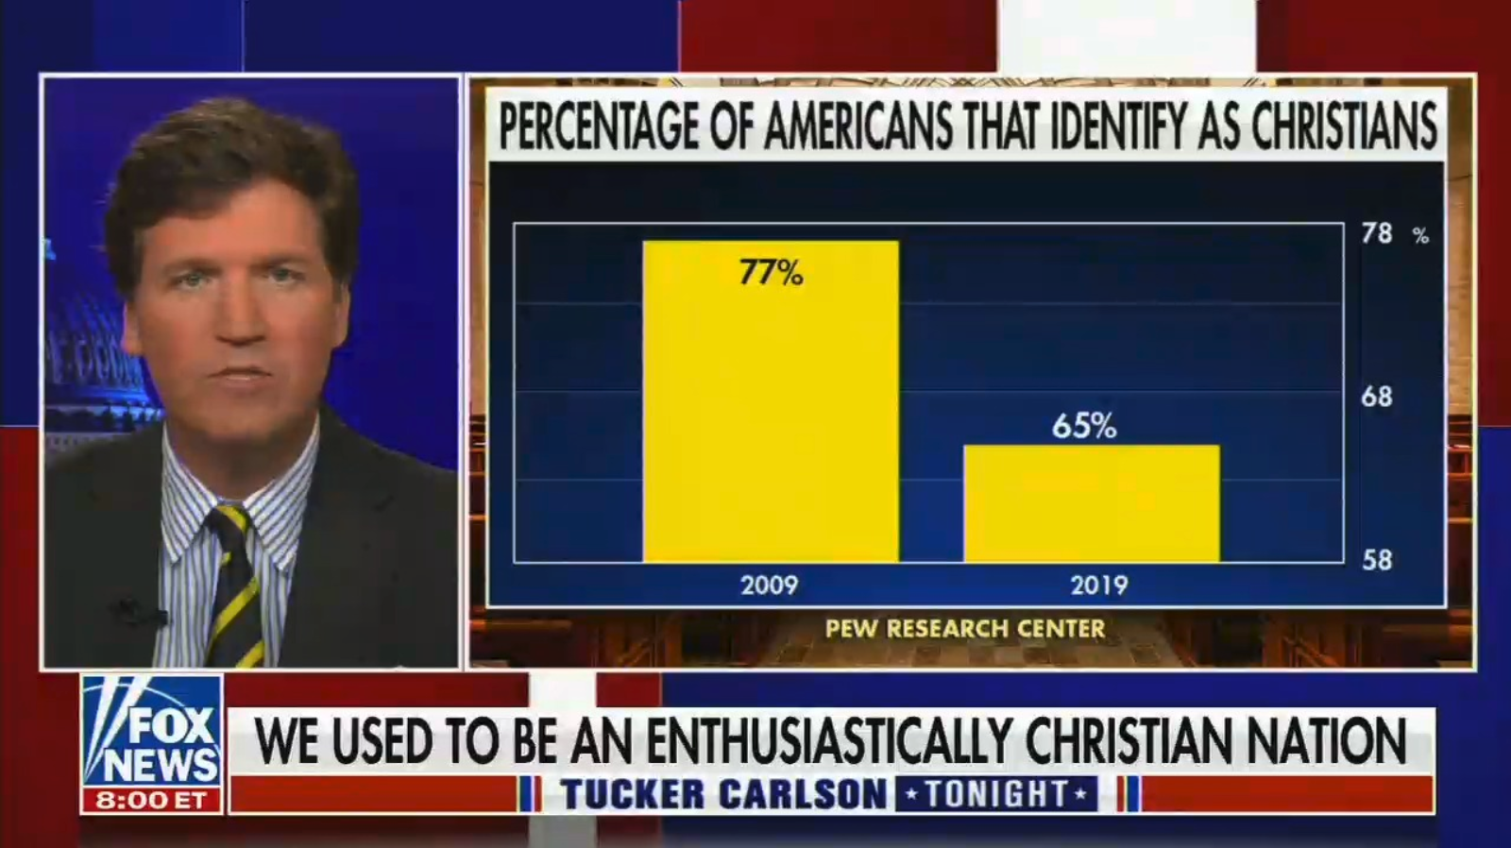

Slide 25
💡
You can break rules
Do what I say, not what I do :)

Slide 26
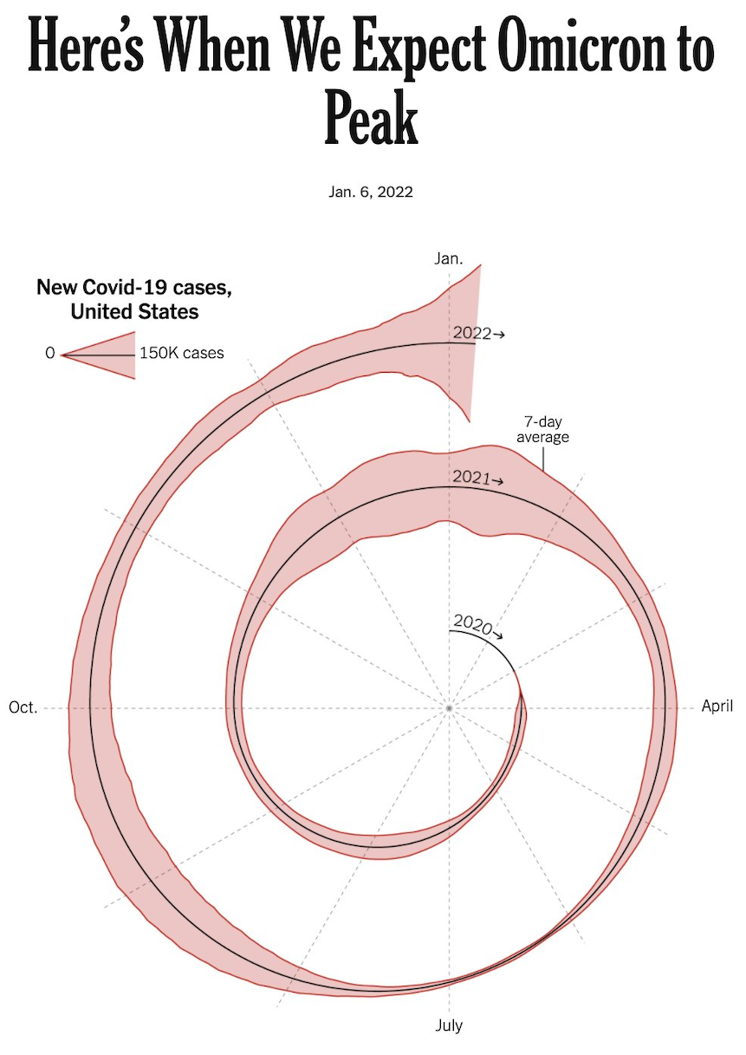
Circular stream graph
Data to viz
Is it appropriate?
New York Times

Slide 27
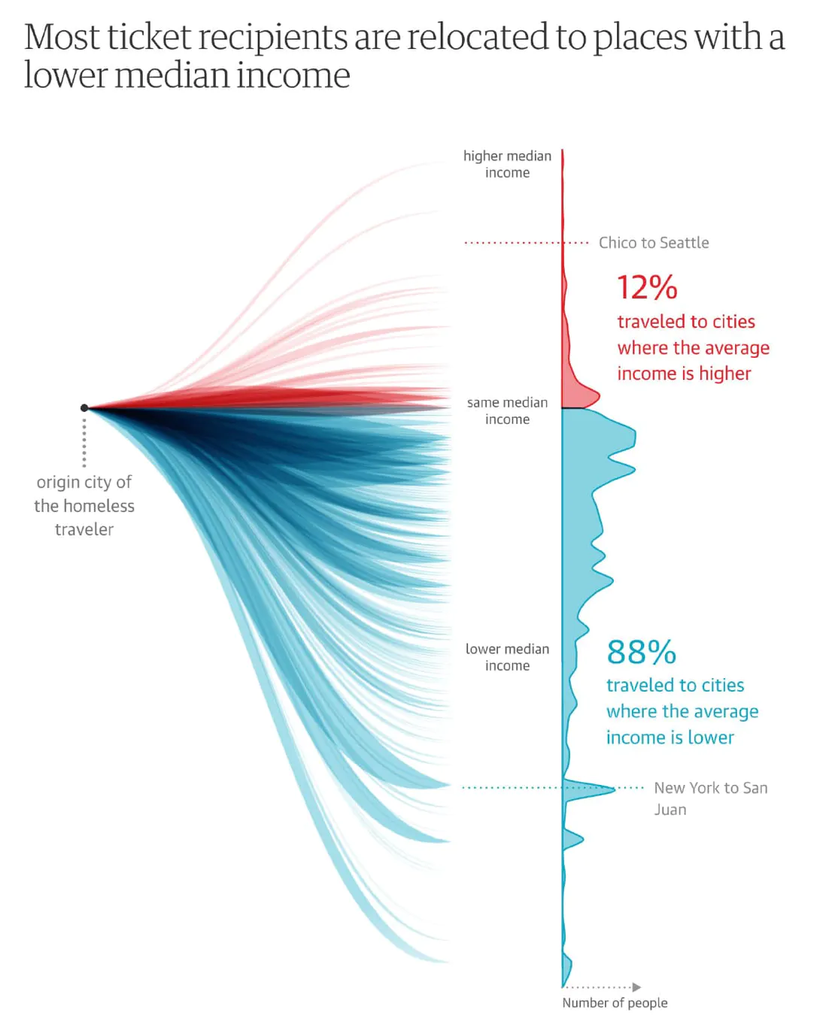
Data to ink Ratio?
Data to viz
Left part is useless, but catch your eyes
Nadieh Bremer

Slide 28
💡
Master the chart diversity

Slide 29
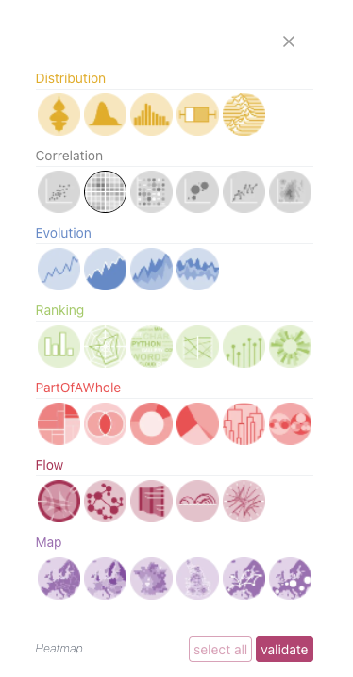
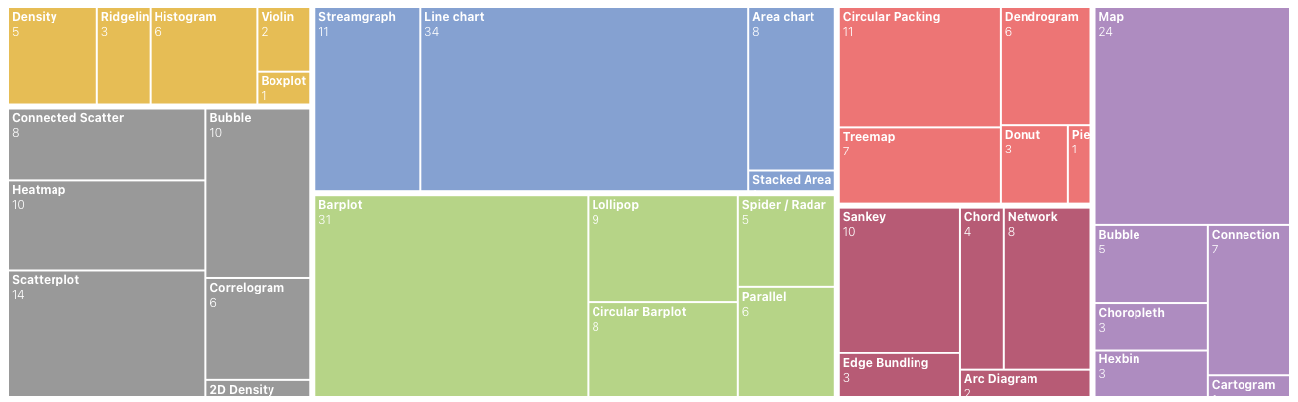
Diversity is high
Knowledge is low
Data to viz

Slide 30
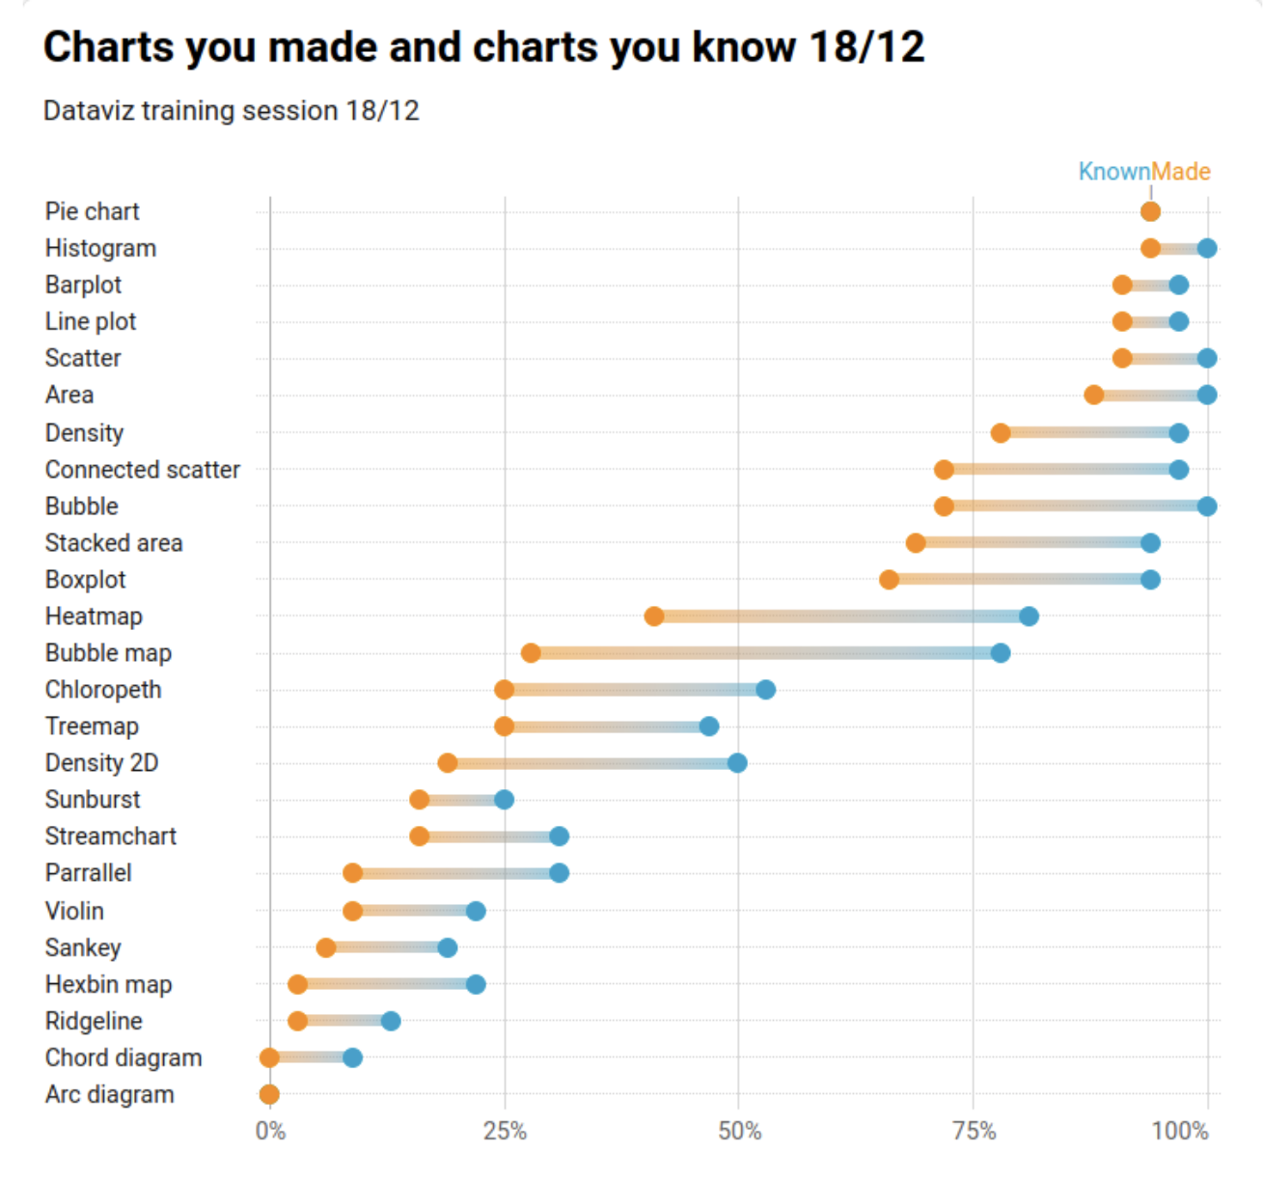
Diversity is high
Data to viz
Knowledge is low

Slide 32
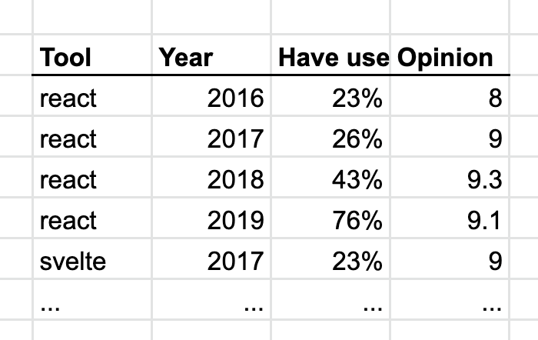
How would you plot this?

Slide 33
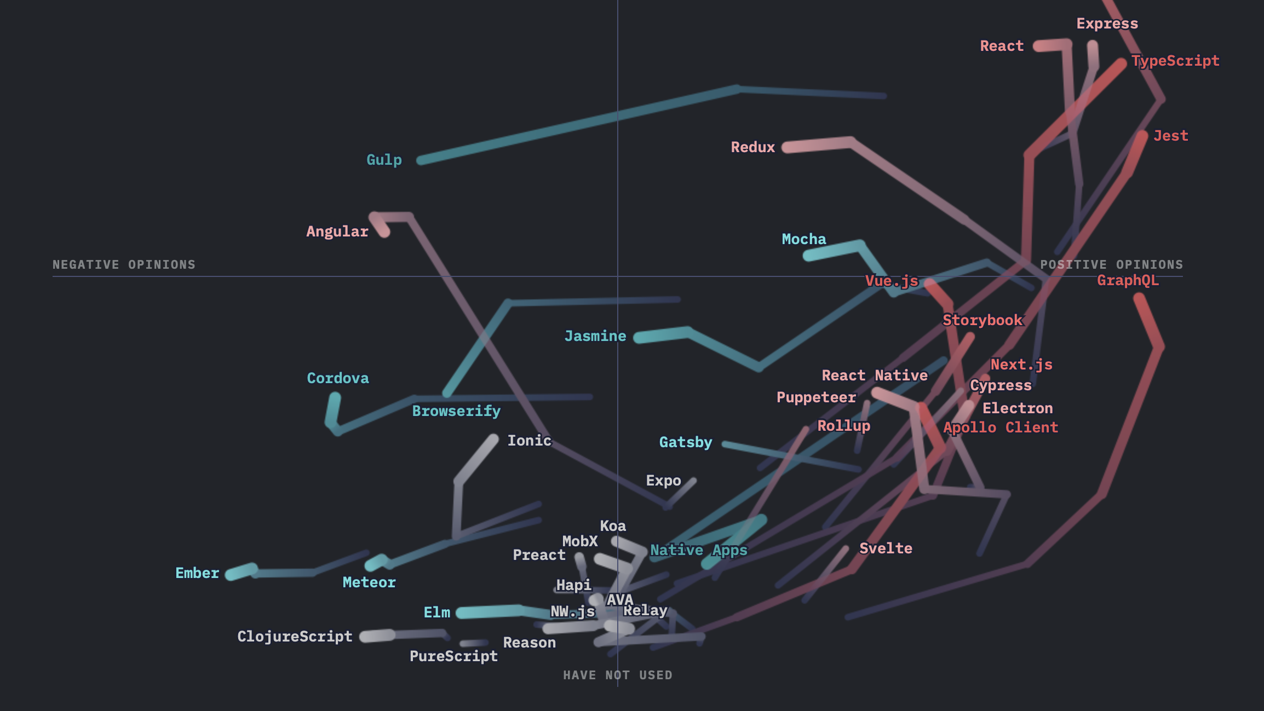
State of JS 2020

Slide 34
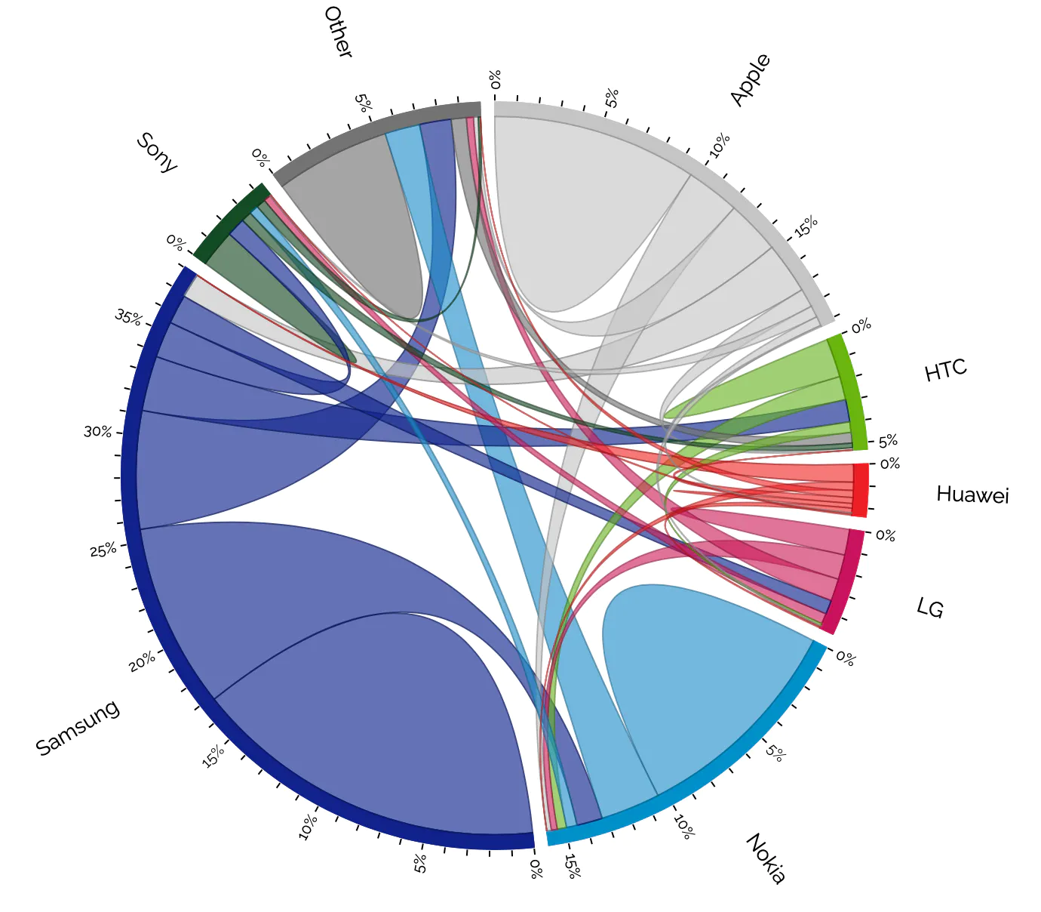
Know your audience
Or teach them
Nadieh Bremer

Slide 35
💡
Beyond chart types

Slide 36
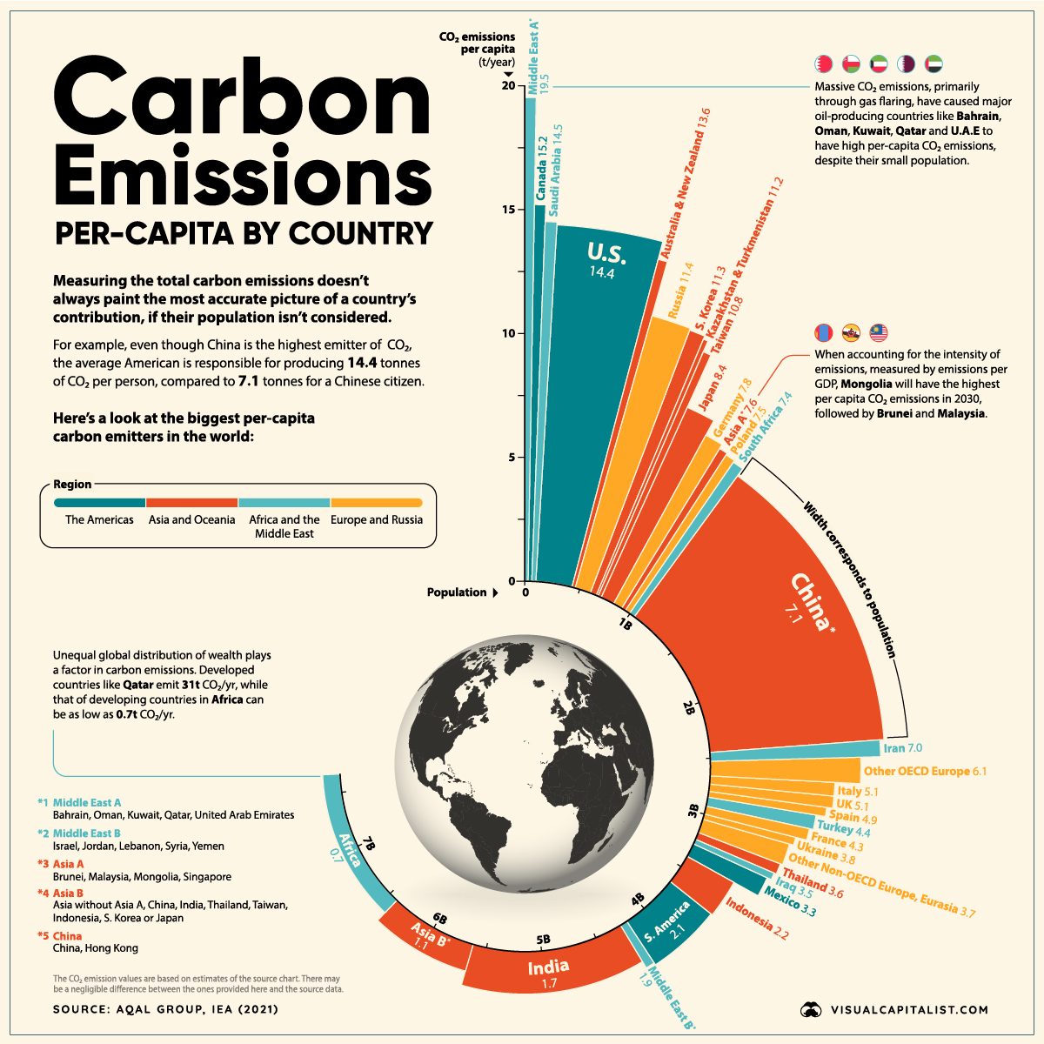
Circular barplot with variable width?
Nobody knows…

Slide 37
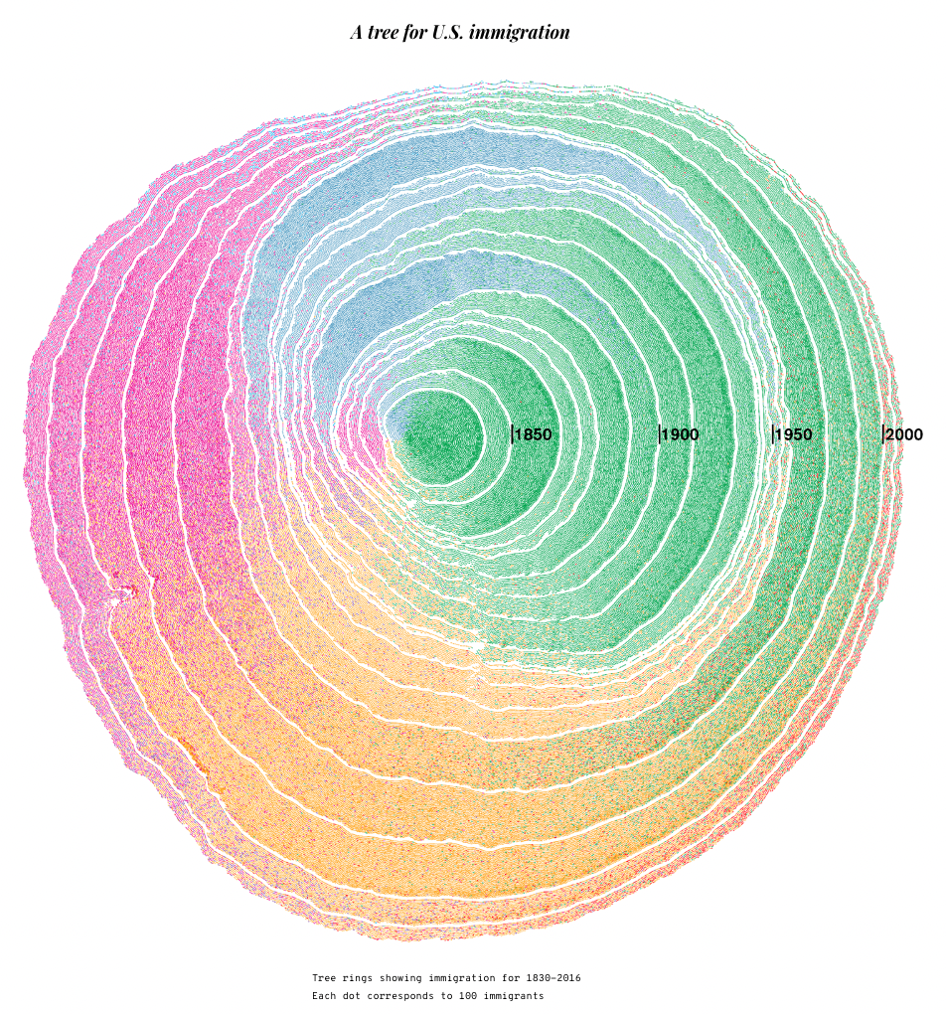
🤷
Pedro Cruz et al.

Slide 38
💡
Annotation is key

Slide 39
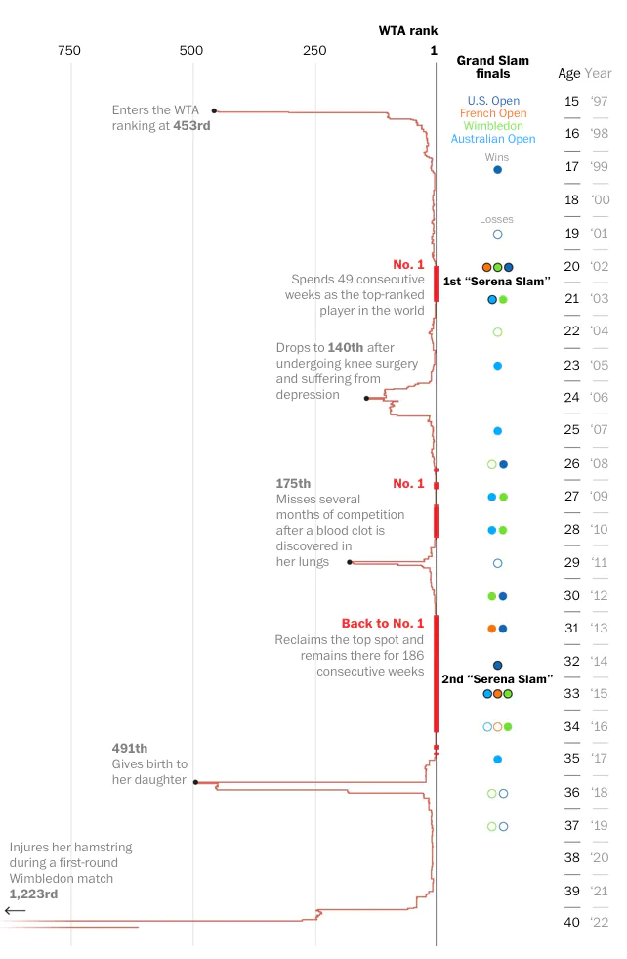
Tell the story ON the chart
Reader does not want to jump from text to chart and reverse
Wahington post

Slide 40
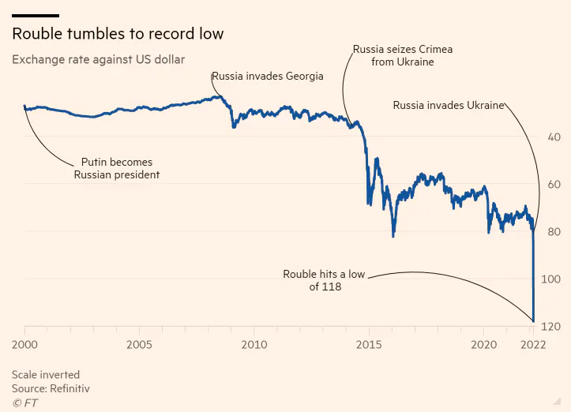
Tell the story ON the chart
Reader does not want to jump from text to chart and reverse
Financial time

Slide 41
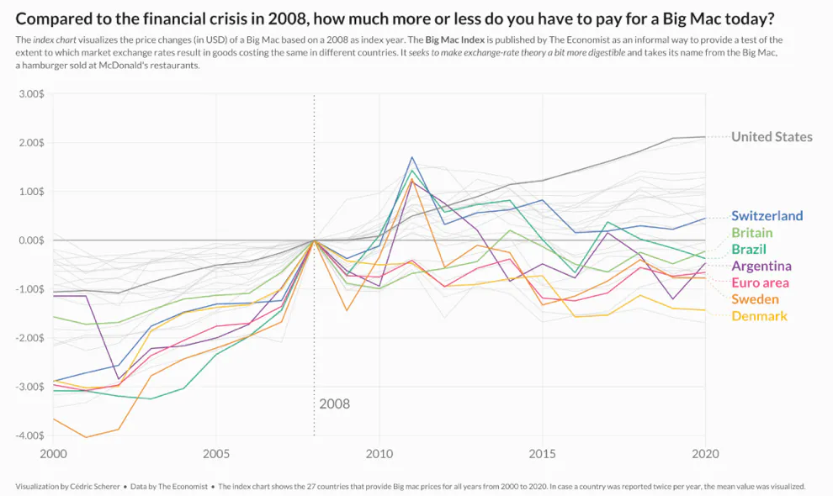
Tell the story ON the chart
Reader does not want to jump from text to chart and reverse
Cedric Scherer

Slide 42
💡
Interactivity?
Use it with care

Slide 43
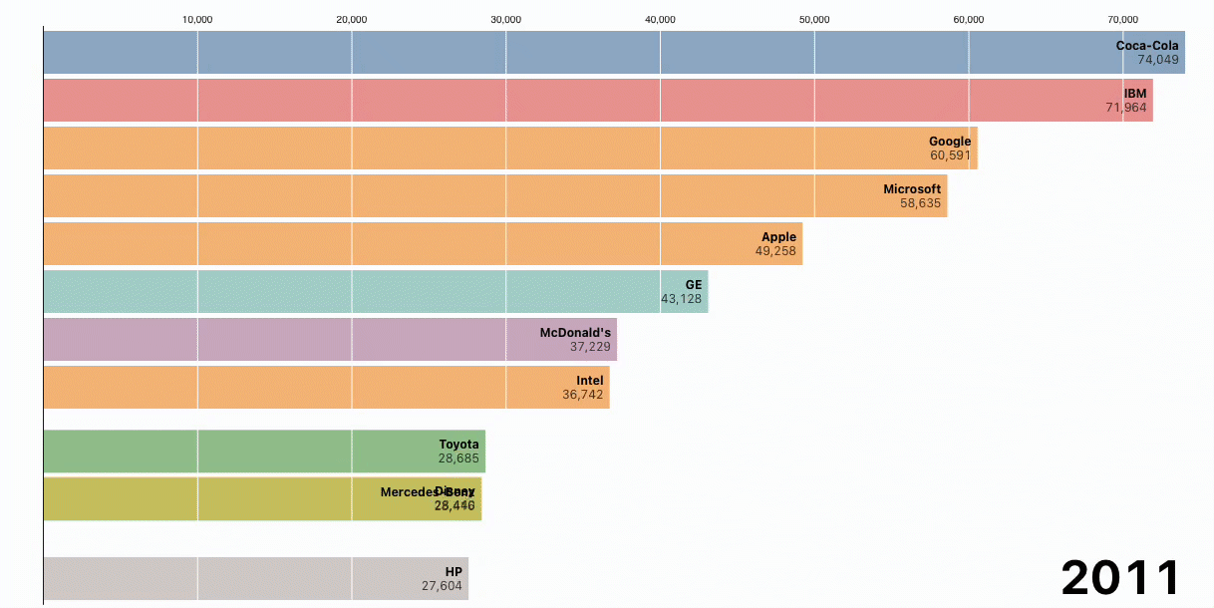
Interactivity !== Animation
Animation is like salt, too much of it spoils the dish
Observable

Slide 44
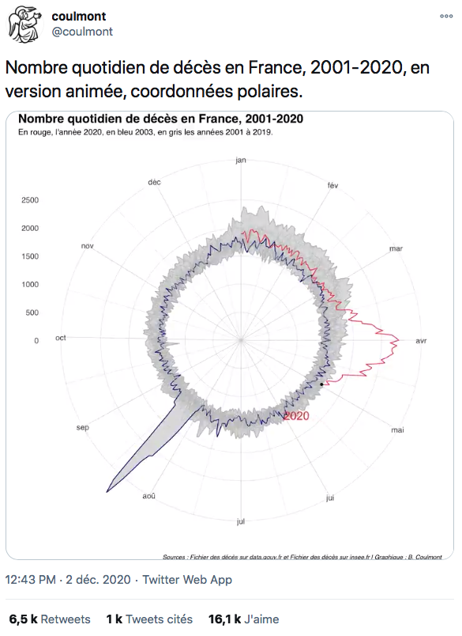
Link

Slide 45
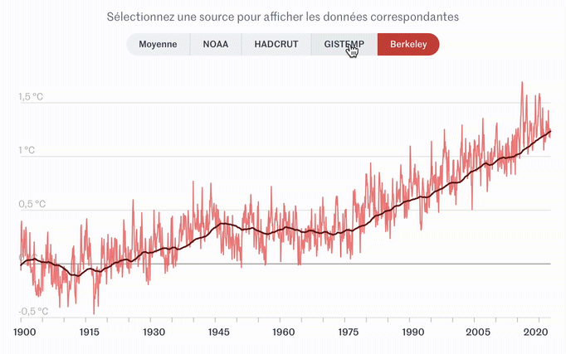
Click & Hover
Le Monde

Slide 46
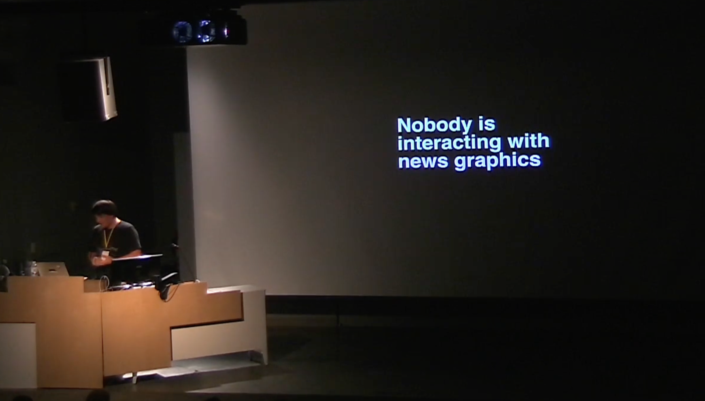
Gregor Aisch

Slide 47
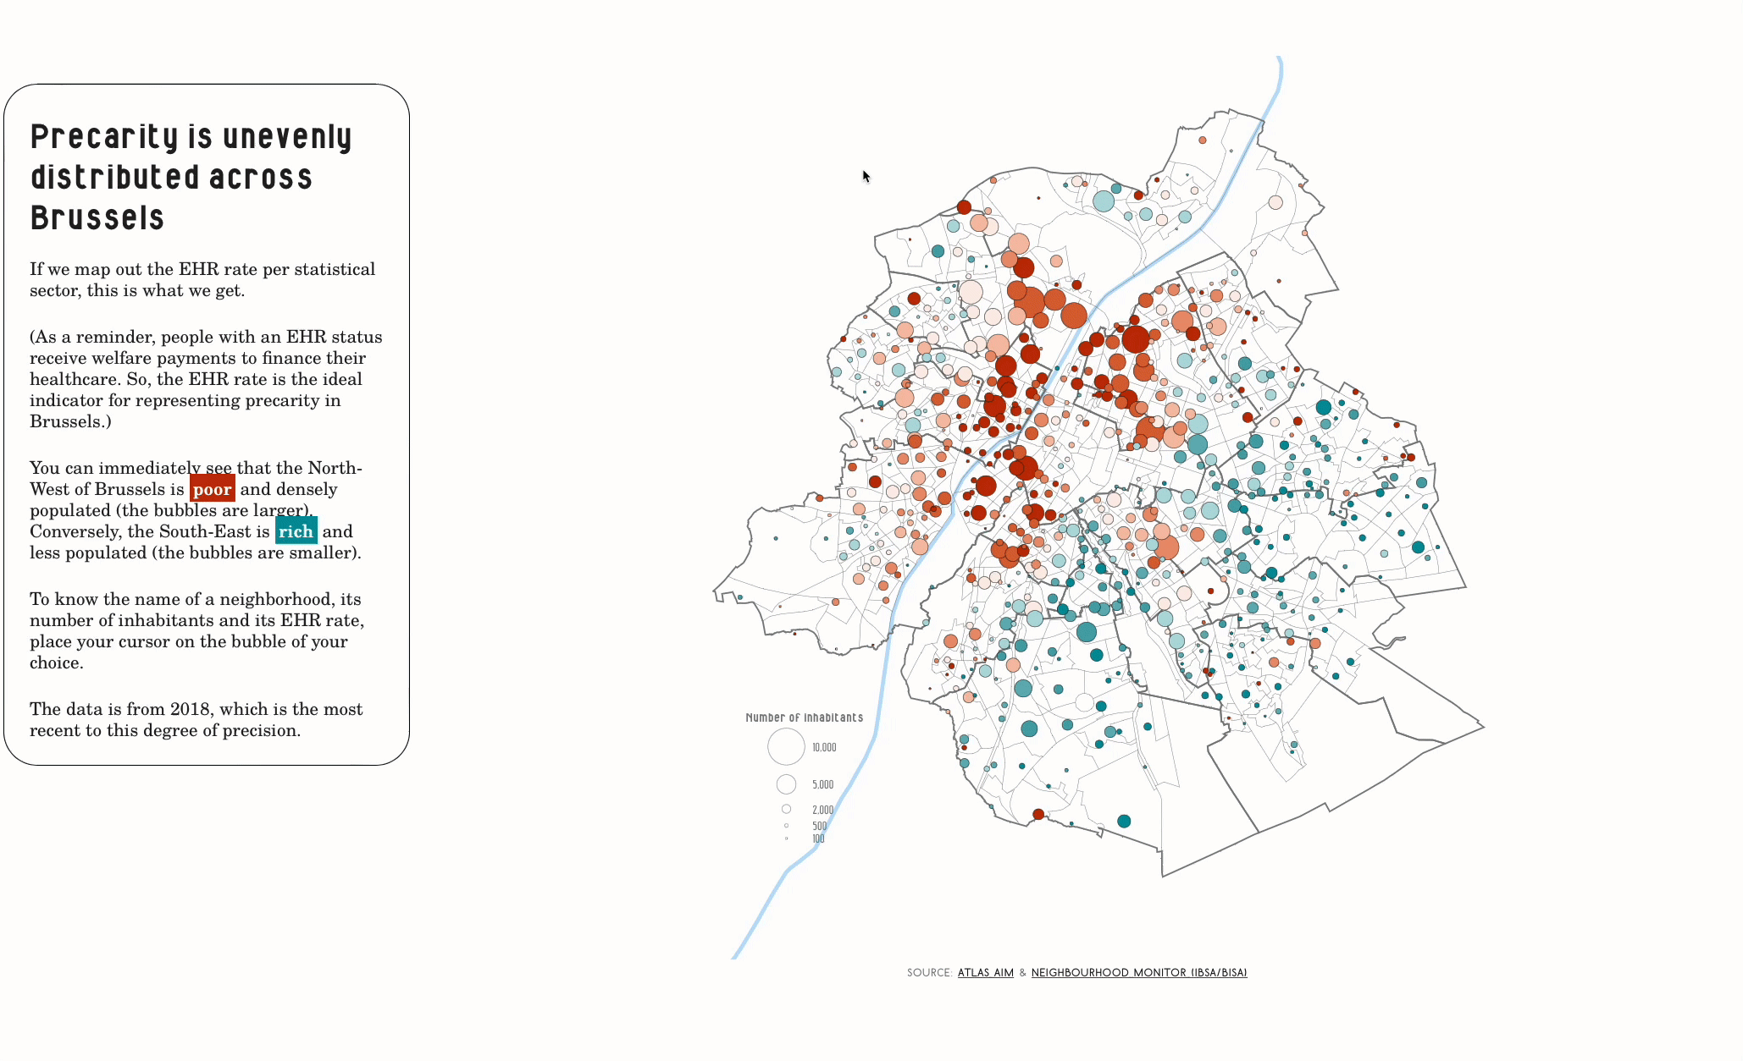
Scrolly-telling
Bruxelles malade

Slide 48
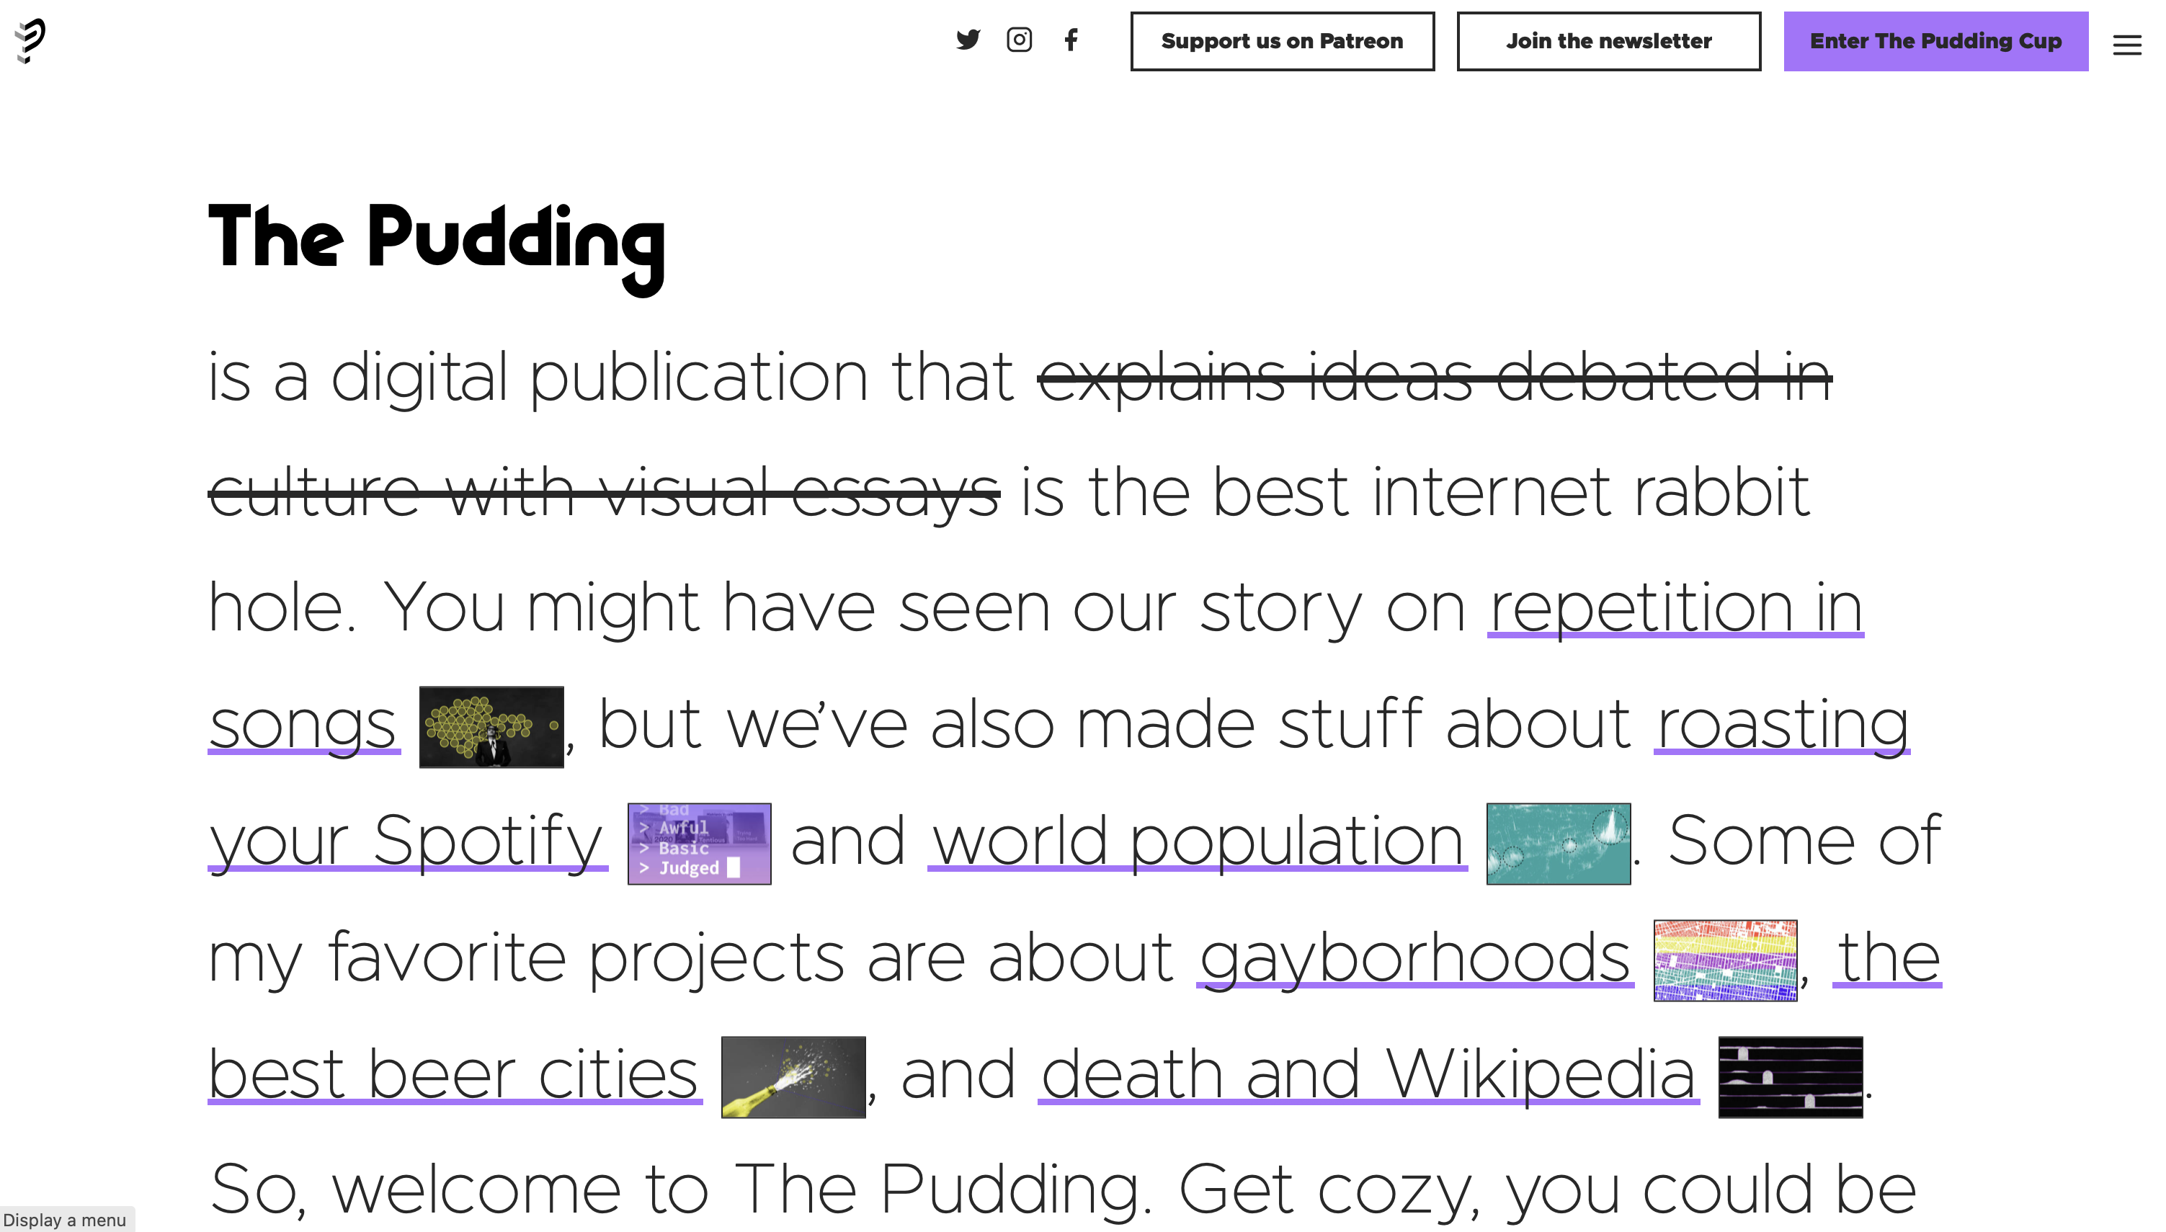

Slide 49
Dataviz as an art?
💡
Kant: “le beau est ce qui plaît universellement sans concept”

Slide 50
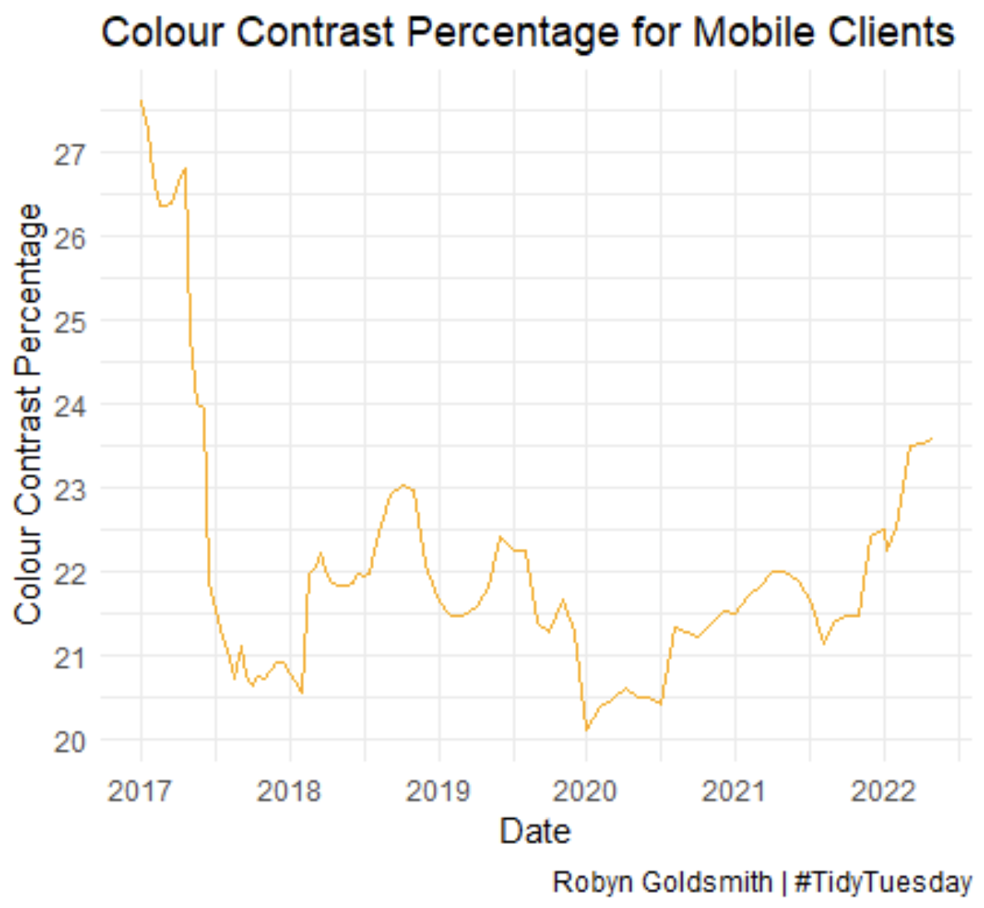

Slide 51
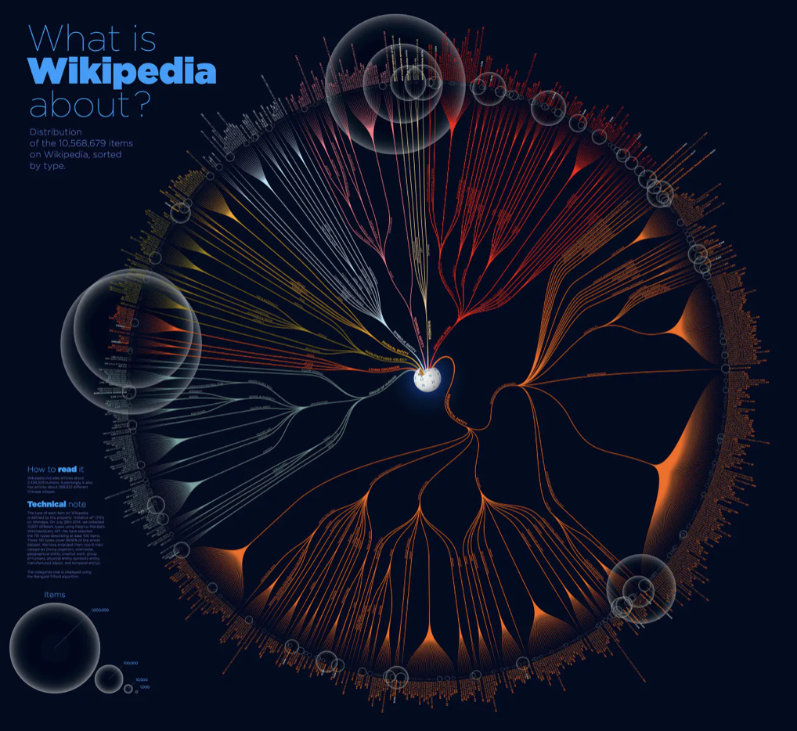
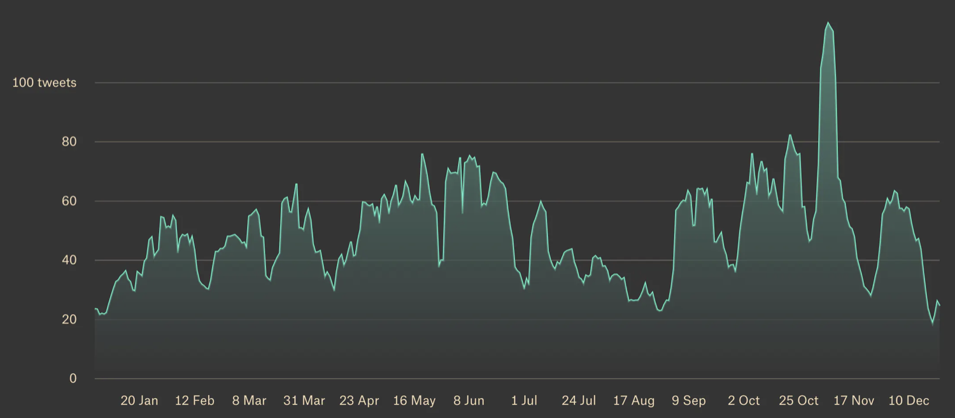
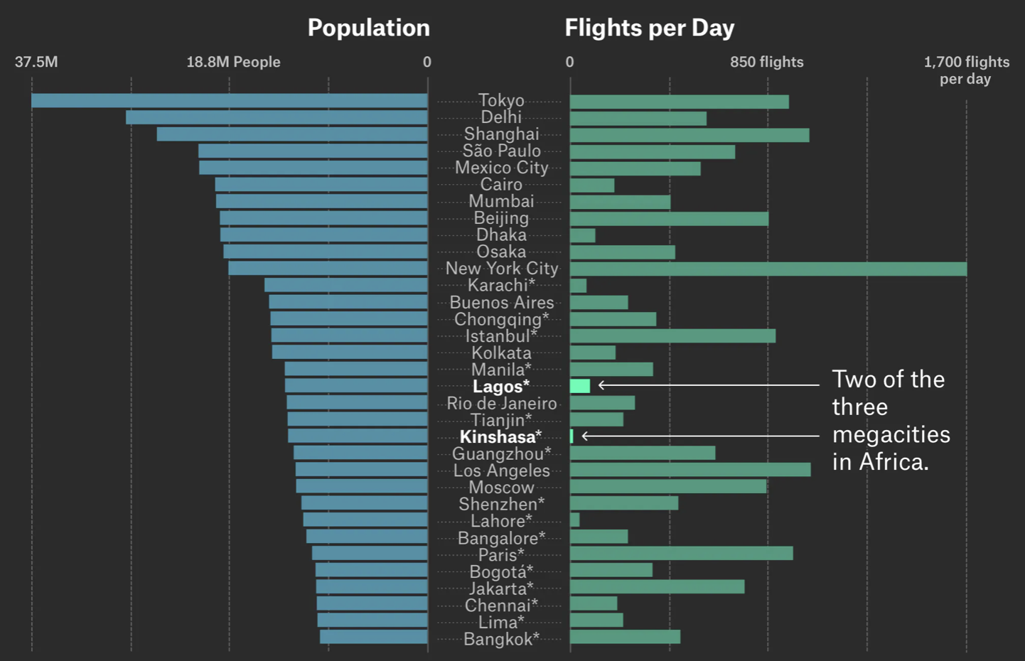
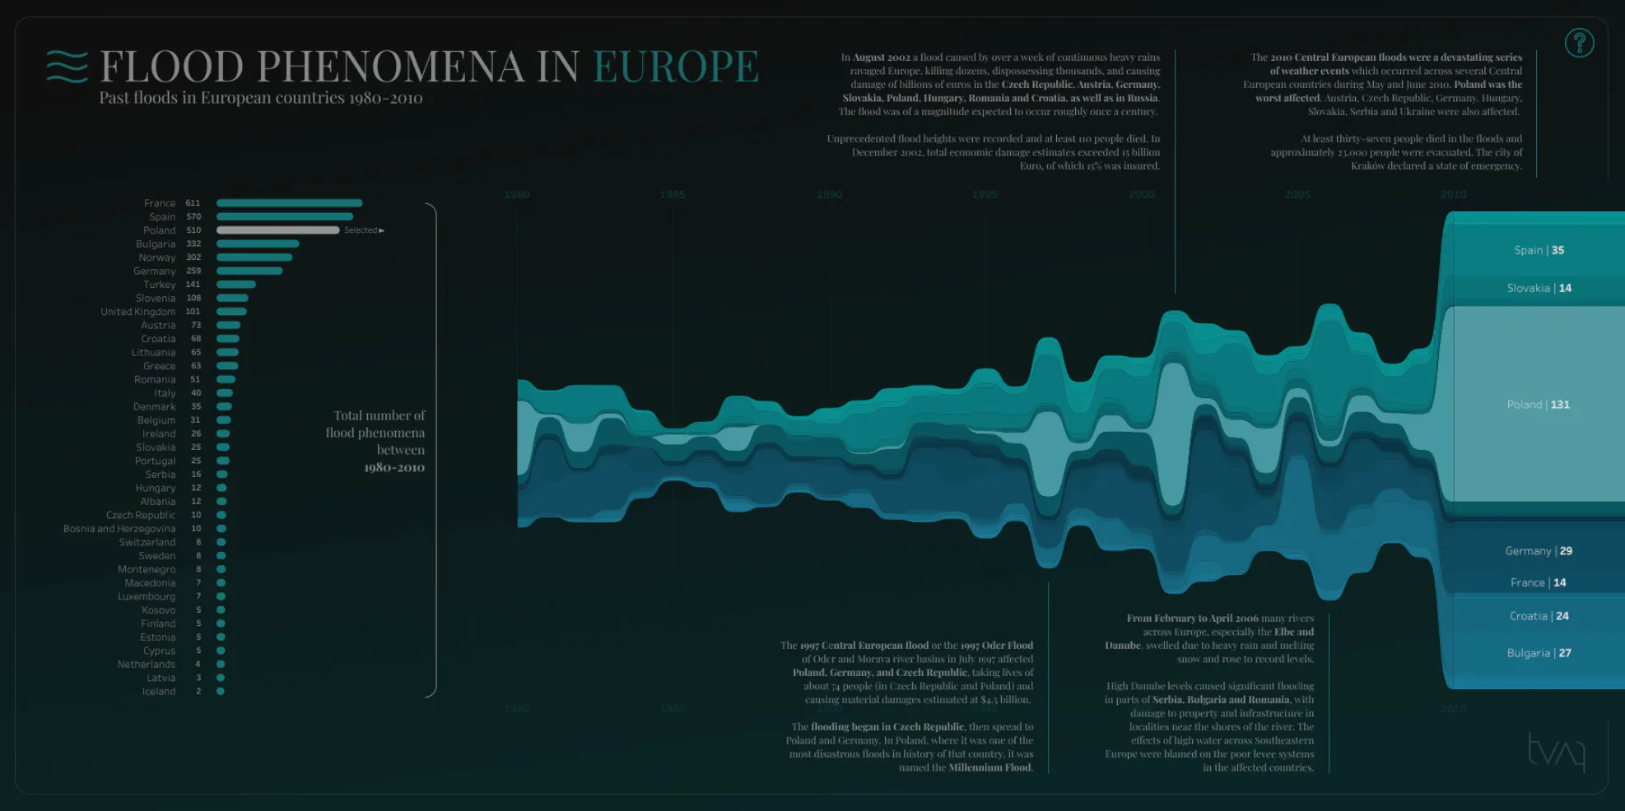
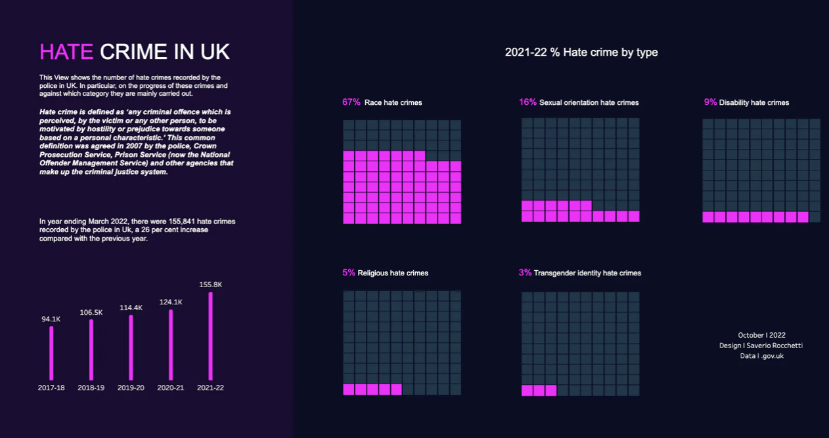

Slide 52
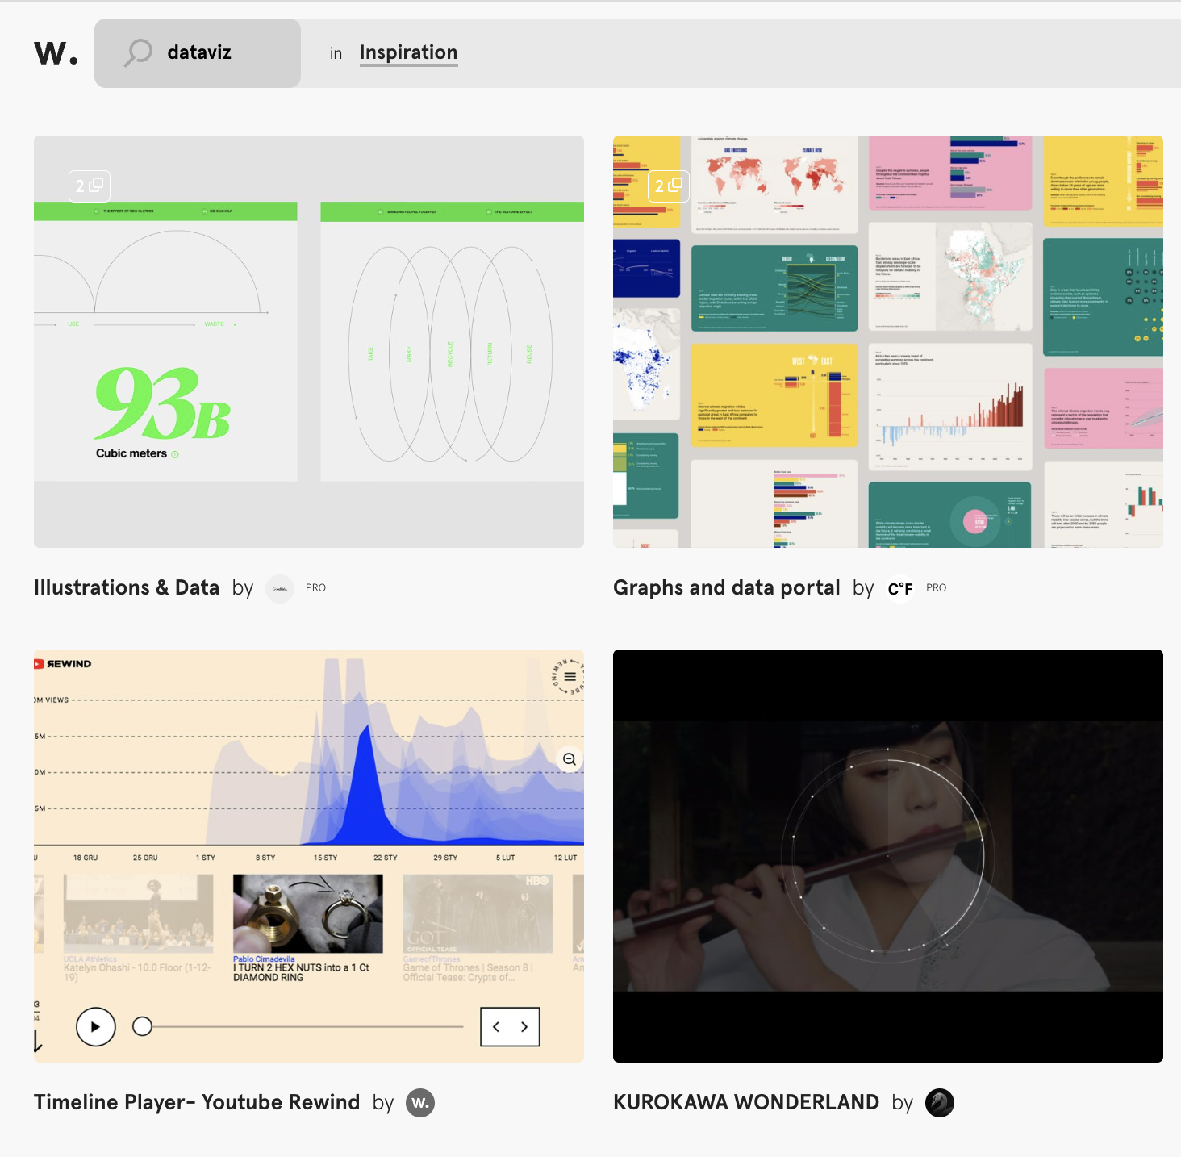
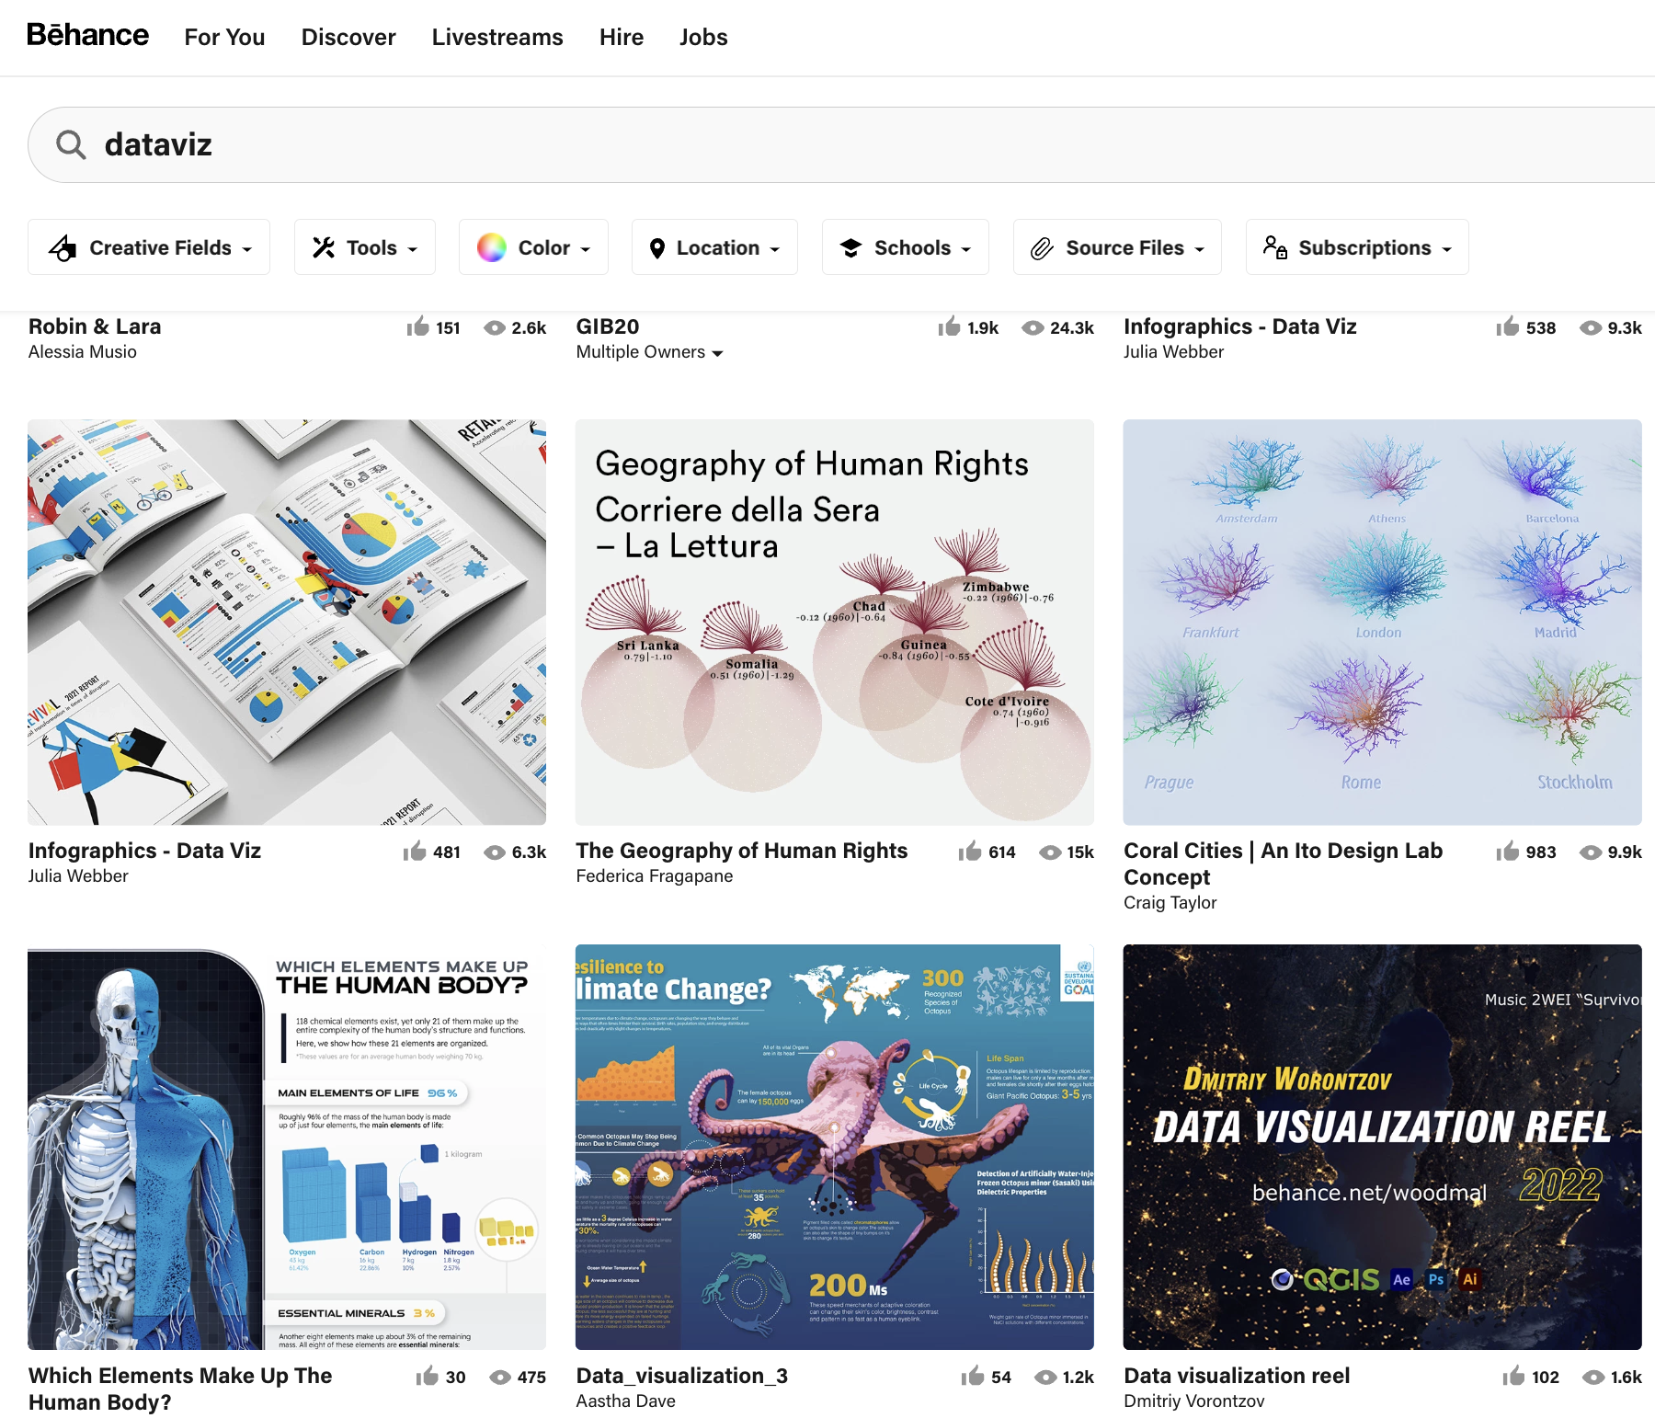
Behance
Awwwards

Slide 53
Sooooo
Take Home Message

Slide 54

💡
Topic is key
Know the rules
Break the rules
Know the chart types
Break the chart types
Use annotation to tell a story
Do not focus on complexity
Learn design skills
Creativity is dying, uniformity is everywhere.
https://www.creativebloq.com/news/logos-look-the-same

Slide 55

🔥
Exciting time for dataviz !

Slide 56
Yan Holtz
Yan-holtz.com
@r_graph_gallery
Dataviz-inspiration.com
github.com/holtzy/Talk

